Slide 1
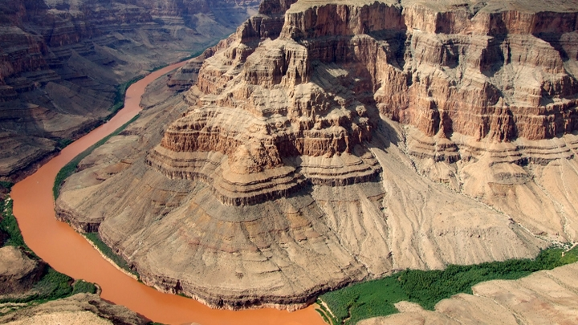
Weathering and Erosion
By: Layla, Raissa.

Slide 2
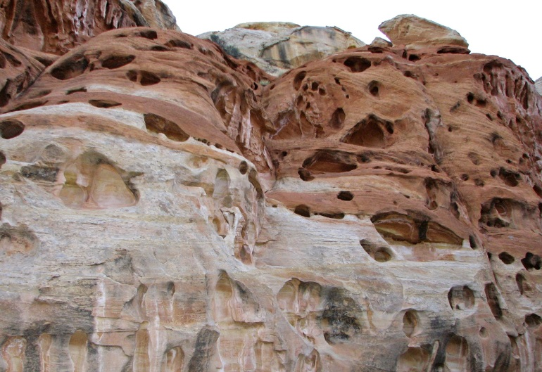
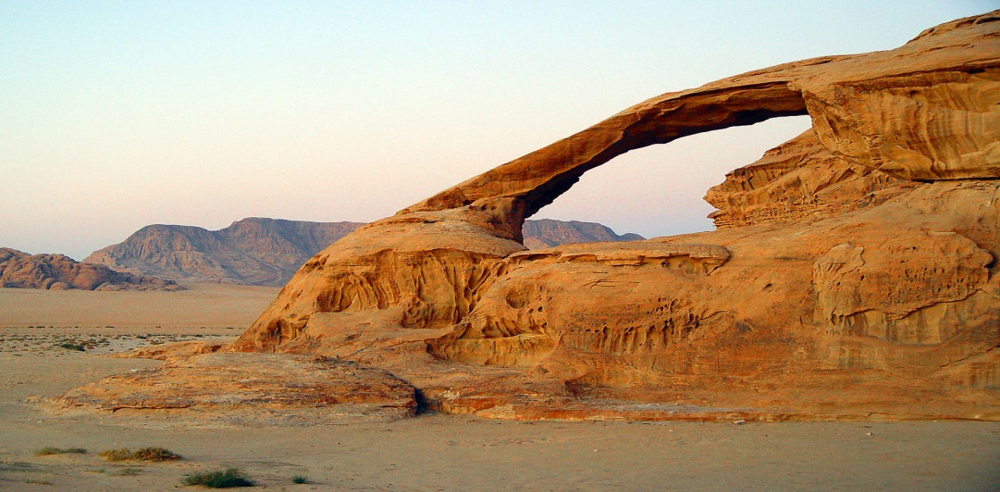
Weathering
The process that slowly breaks down natural materials.
Weathering can be caused by two forces: Physical force, or chemical reaction.
Weather includes temperature, such as, wind, rain, and snowfall.

Slide 3
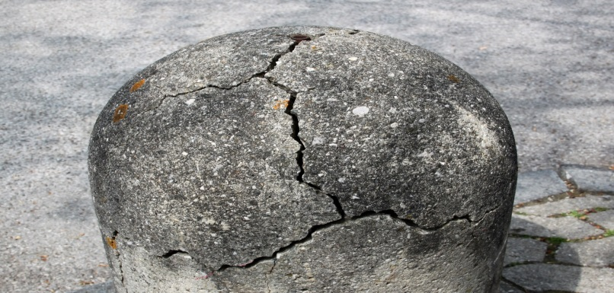
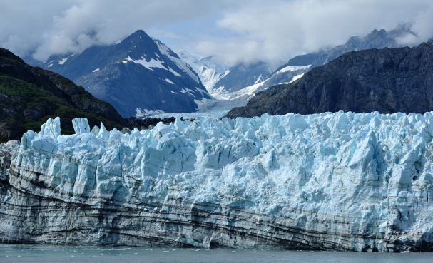
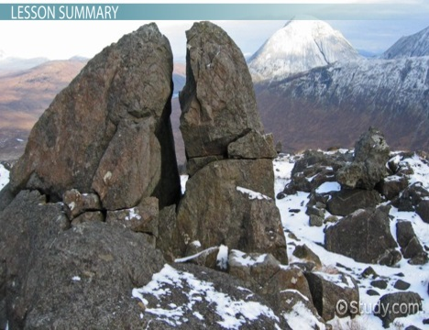
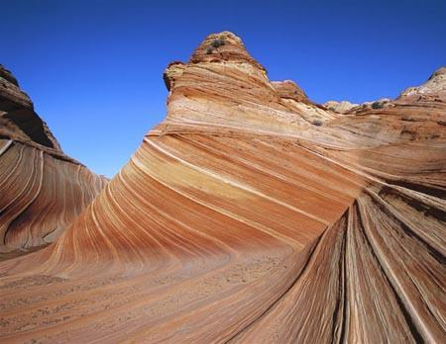
Mechanical Weathering
The weathering that is caused by physical force. Physical force can also cause weathering.
Examples
Ice Wedging
Wind
Water/Rocks
Glacier
Occurs over and over the cracked rocks, and may break off.
Sand and small rocks that are carried by the wind, slowly breaks into small pieces. Which causes windstorm
Rocks carried by fast-flowing water, rub each other to get smother.
Glacier like its not moving, but glacier moves very slowly because of it’s weight.

Slide 4
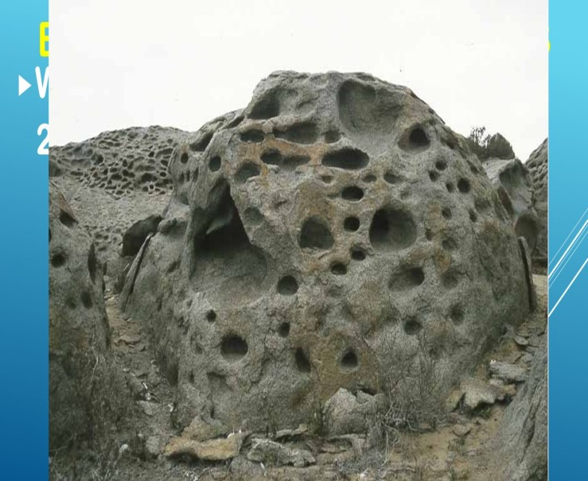
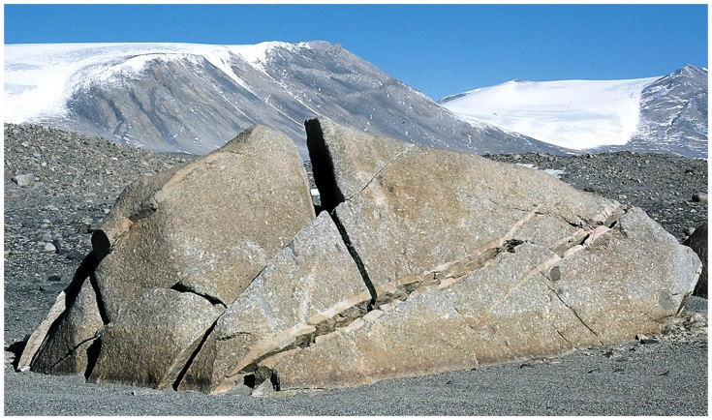
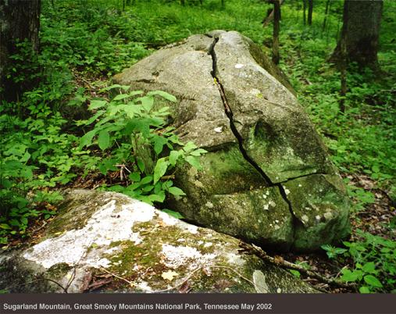
Chemical Weathering
Chemical can break
Is when chemical reaction happens between water, and air, etc..
Examples
Air
Rain
Snow
Oxygen in air rust any iron in any mineral found in rocks. Which cause chemical weathering.
The limestone that are used to make statues, and building have been damaged by acid rain. After many years, the limestone dissolves which causes the limestone to crumble.
Same as the rain, the snow melts, and does the same job as the rain.

Slide 5
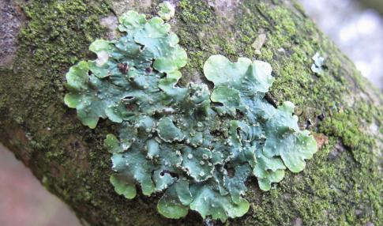
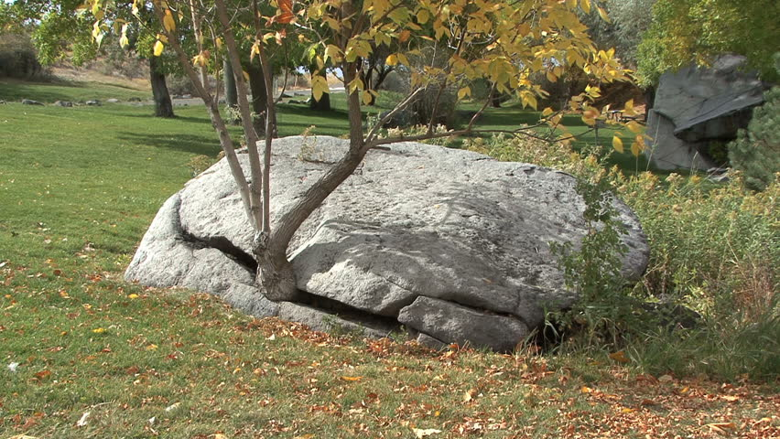
Biological Weathering
A living think that caused mechanical, and chemical weathering.
Lichen
Plants
It grows on rocks. It also uses come materials in rocks.
The plant grows inside cracks, and split the rock.

Slide 6
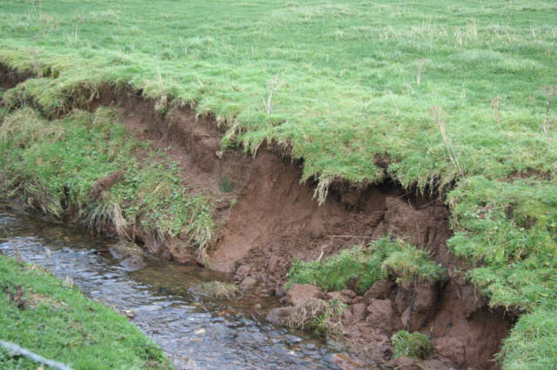
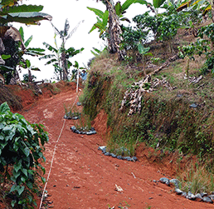
Erosion
The movement of weathered rocks from one place to another
Erosion can occur as fast as a land slide .
a small earthquake moves slow it can loose the rocks.

Slide 7
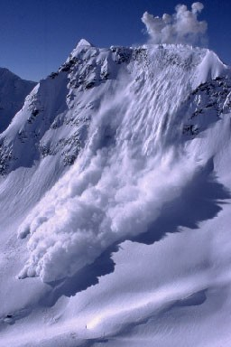
Gravity
Gravity causes by rock falling from mountains which causes avalanches.
On mountains earthquake may loosenend the rocks to fall, but the stronger force which is gravity causes the rocks to fall; landslide.

Slide 8
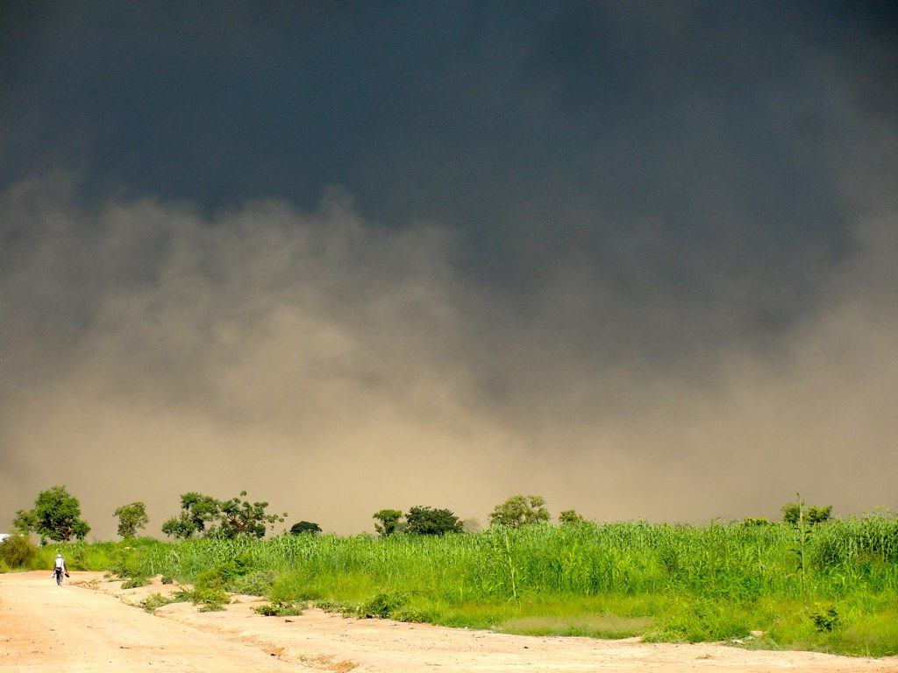
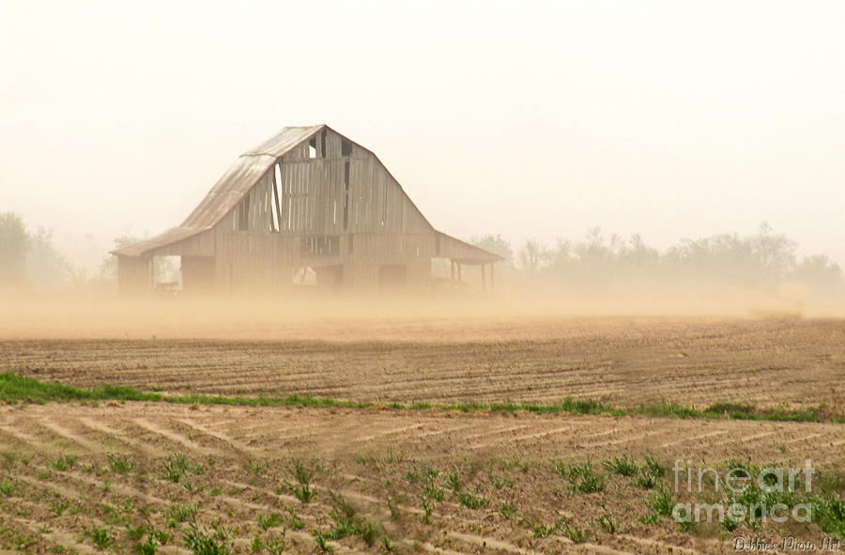
Wind
Wind carries small rocks, sand, dust etc...for many Km.
Particles in air are deposes when the wind is separated up
A storm can, dust storms demo the wind power it happens because of dry land, and soils that were not rich enough.

Slide 9
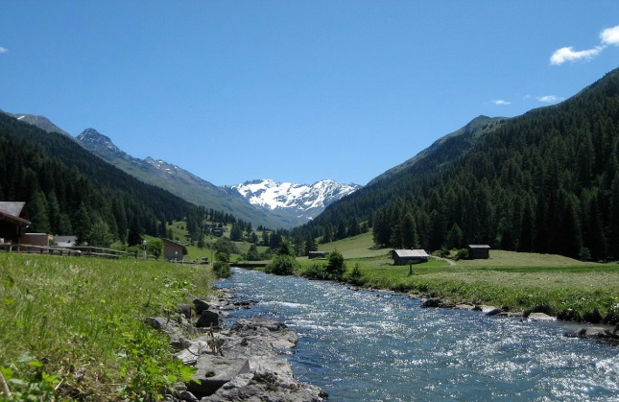
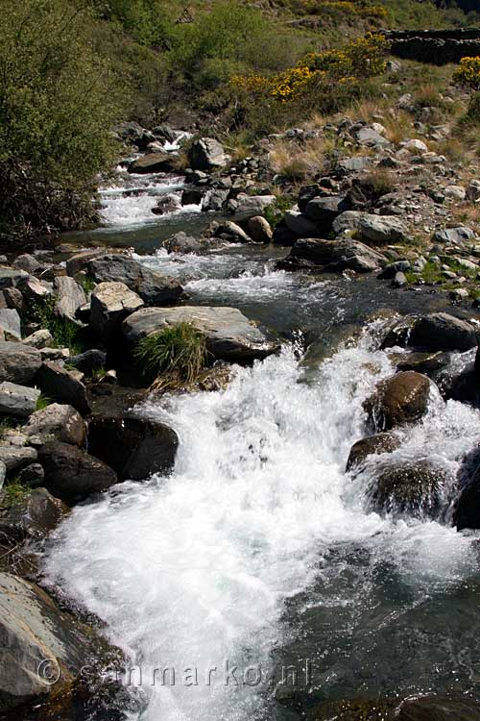
Water
Slowly a river can move from its place by making cuts between mountains,valley which transform the water from its place to another.
It transform the water through valleys the water forming valley way.
Delta, the river often break into a number of smaller channels, separated by islands of sediment.

Slide 10
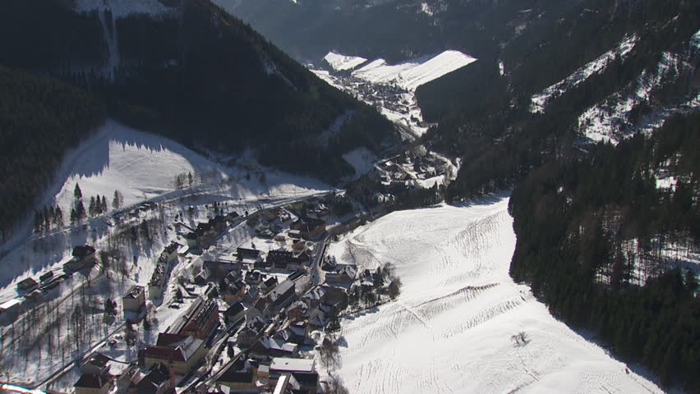
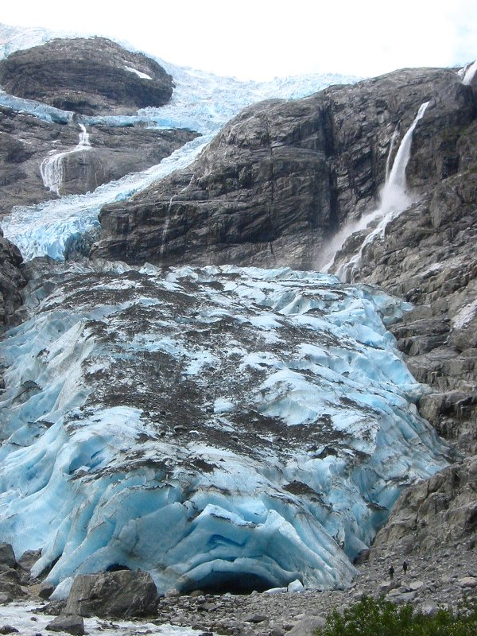
Ice
Ice builds up in valley as it build up the pressure will continua and turn the snow to ice, which transforms to glacier.
Glacier can leave large, separate boulders in areas where they would not usually be.
These out-of-place boulders are called erratic's.
The results of long narrow inlets of the sea are called fiords.
Howe sound and knights inlets are two of the many fiords that are found beside the coast land of B.C.

